Slide 1
Hypertension and Alzheimer’s disease
醫學二 李忻為
醫學四 賴柏瑞

Slide 2
outline
Introduction
Univariable analysis
Stratification
model selection and result
Discussion

Slide 3
1.
introduction

Slide 4
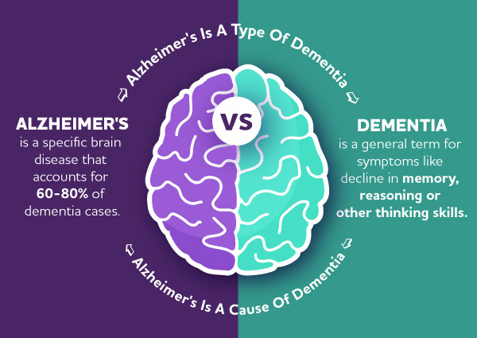
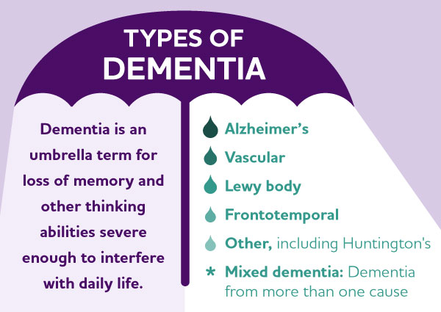
Dementia and Alzheimer’s
Notes:
Chengxuan Qiu, Dialogues in Clinical Neuroscience, 11:2, 111-128

Slide 5
Prevalence
In Taiwan (2021)
4 % aged over 65
age | 65-69 | 70-74 | 75-79 | 80-84 | 85-89 | ≥90
Prevalence(％) | 3.40 | 3.46 | 7.19 | 13.03 | 21.92 | 36.88
Chengxuan Qiu, Dialogues in Clinical Neuroscience, 11:2, 111-128
Notes:
Chengxuan Qiu, Dialogues in Clinical Neuroscience, 11:2, 111-128

Slide 6
Risk factors
Elderly
Female
APOE e4 carrier
fewer years of education
less physical activities
Vascular disease
Hypertension, hyperlipidemia, type 2 DM
Smoking
Reduced cerebral perfusion
Panapalli Ates et al. 2016, Anstey et al2007.
Riedel et al. 2016, Safieh et al. 2019, Catherine et al. 2007, Cass et al. 2017, Viiayan and Reddy, 2016
Notes:
Panpalli Ates et al., 2016
Vijayan and Reddy, 2016
Viiayan and Reddy, 2016

Slide 7
Study design
Case-control study
Case: Alzheimer’s disease
Case ( n = 250 ) vs. control ( n = 400 )
Sample
Cases were identified in 2007-2010 in 3 hospitals
Controls were selected at same time period

Slide 8
2.
Table 1

Slide 9
Data processing
Continuous variables
Age, grouped by below or over 75 (mean)
Education year, grouped by below or over 12 ( compulsory education )
BMI, grouped by below or over 24 ( 國健署過重標準）
Independent two-sample t-test

Slide 10
Data processing
Categorial variables: defined as dichotomous variables
Chronic conditions: hypertension, hyperlipidemia, diabetes, cardiovascular dz
Habits: coffee, tea, smoking, alcohol
Physical activities: physical, cognitive, and social activities
Crude odds ratio

Slide 11
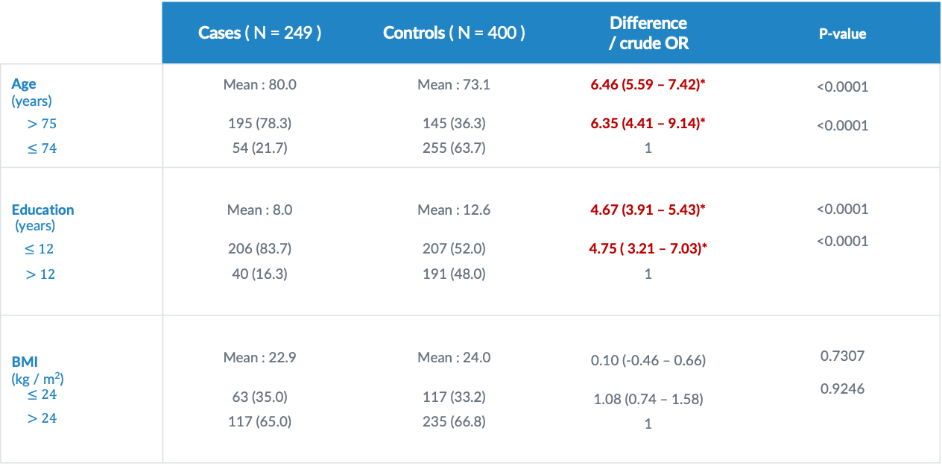
Table 1 : continuous variables
 | Cases ( N = 249 ) | Controls ( N = 400 ) | Difference / crude OR | P-value
Age (years) $>75$ $≤74$ | Mean : 80.0 195 (78.3) 54 (21.7) | Mean : 73.1 145 (36.3) 255 (63.7) | 6.46 (5.59 – 7.42)* 6.35 (4.41 – 9.14)* 1 | <0.0001 <0.0001
Education (years) $≤12$ $>12$ | Mean : 8.0 206 (83.7) 40 (16.3) | Mean : 12.6 207 (52.0) 191 (48.0) | 4.67 (3.91 – 5.43)* 4.75 ( 3.21 – 7.03)* 1 | <0.0001 <0.0001
BMI (kg / m²) $$≤24$$ $>24$ | Mean : 22.9 63 (35.0) 117 (65.0) | Mean : 24.0 117 (33.2) 235 (66.8) | 0.10 (-0.46 – 0.66) 1.08 (0.74 – 1.58) 1 | 0.7307 0.9246

Slide 12
Table 1 : basic
 | Cases ( N = 249 ) | Controls ( N = 400 ) | Crude OR | P-value
Sex Female Male | 155 (55.0) 94 (45.0) | 209 (52.3) 191 (47.7) | 1.51 (1.09 – 2.08)* 1 | 0.0126
APOE e4 status Carrier Non-carrier | 97 (40.6) 142 (59.4) | 60 (16.2) 311 (83.8) | 3.54 (2.43 – 5.17)* 1 | <0.0001

Slide 13
Table 1 : habits
 | Cases ( N = 249 ) | Controls ( N = 400 ) | Crude OR | P-value
Alcohol Yes No | 32 (12.9) 217 (87.1) | 40 (10.0) 359 (90.0) | 1.32 (0.81 – 2.17) 1 | 0.2655
Smoking Yes No | 58 (23.3) 191 (76.7) | 71 (17.8) 328 (82.2) | 1.48 (0.95 – 2.07) 1 | 0.0882
Passive smoking Yes No | 74 (33.5) 147 (66.5) | 98 (25.1) 293 (74.9) | 1.51 (1.05 – 2.16)* 1 | 0.0260

Slide 14
Table 1 : drinks
 | Cases ( N = 249 ) | Controls ( N = 400 ) | Crude OR | P-value
Coffee Yes No | 47 (18.9) 202 (81.1) | 127 (31.8) 272 (68.2) | 0.48 (0.34 – 0.73)* 1 | 0.0003
Tea Yes No | 65 (26.1) 184 (73.9) | 137 (34.3) 262 (65.7) | 0.68 (0.48 – 0.96)* 1 | 0.0278

Slide 15
Table 1 : activities
 | Cases | Controls | Crude OR | SATURDAY
Regular physical activity No Yes | 105 (42.2) 144 (57.8) | 116 (29.1) 283 (70.9) | 1.78 (1.28 – 2.48)* 1 | 0.0006
Regular cognitive activity No Yes | 21 (8.4) 228 (91,6) | 32 (8.0) 367 (92.0) | 1.06 (0.59 – 1.88) 1 | 0.8517
Regular social activity No Yes | 173 (69.5) 76 (30.5) | 194 (48.6) 205 (51.4) | 2.41 (1.72 – 3.36)* 1 | <0.0001

Slide 16
Table 1 : chronic condition
 | Cases ( N = 249 ) | Controls ( N = 400 ) | Crude OR | P-value
Diabetes Yes No | 47 (18. 9) 202 (81.1) | 58 (14.5) 341 (85.5) | 1.37 (0.90 – 2.09) 1 | 0.1448
Hyperlipidemia Yes No | 42 (17.1) 204 (82.9) | 122 (30.7) 276 (69.3) | 0.47 (0.31 – 0.69)* 1 | <0.0001
Cardiovascular dz Yes No | 55 (22.1) 194 (77.9) | 119 (29.8) 280 (70.2) | 0.67 (0.46 – 0.96)* 1 | 0.0307
Hypertension Yes No | 95 (38.2) 154 (61.8) | 218 (54.6) 181 (45.4) | 0.51 (0.37 – 0.71)* 1 | <0.0001

Slide 17
summary of table 1
Significant crude ORs > 1 :
Age Sex
Passive smoking APOE e4 carrier
No physical activities No social activities
Significant crude ORs <1 :
Coffee drinking Tea drinking
Hyperlipidemia Cardiovascular dz
Hypertension

Slide 18
3.
stratification
hypertension (E) --> AD (DZ)

Slide 19
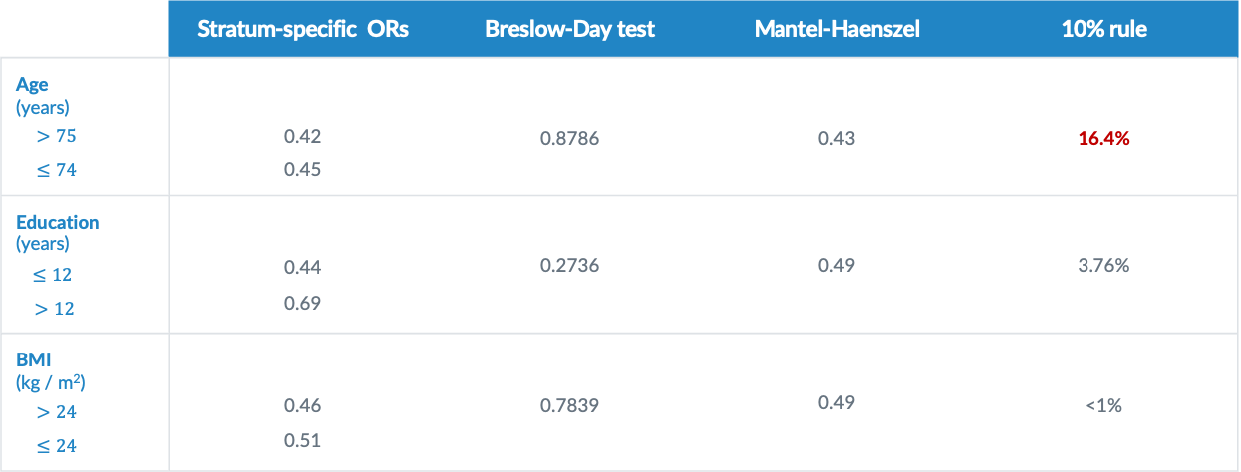
Stratification : continuous
 | Stratum-specific ORs | Breslow-Day test | Mantel-Haenszel | 10% rule
Age (years) $>75$ $≤74$ | 0.42 0.45 | 0.8786 | 0.43 | 16.4%
Education (years) $≤12$ $>12$ | 0.44 0.69 | 0.2736 | 0.49 | 3.76%
BMI (kg / m²) $>24$ $≤24$ | 0.46 0.51 | 0.7839 | 0.49 | <1%

Slide 20
Stratification : basic
 | Stratum-specific ORs | Breslow-Day test | Mantel-Haenszel | 10% rule
Sex Female Male | 0.50 0.49 | 0.9413 | 0.50 | 2.94%
APOE e4 status Carrier Non-carrier | 0.65 0.50 | 0.5045 | 0.54 | 5.03%

Slide 21
Stratification: habits
 | Stratum-specific ORs | Breslow-Day test | Mantel-Haenszel | 10% rule
Alcohol Yes No | 0.44 0.52 | 0.7551 | 0.51 | <1%
Smoking Yes No | 0.34 0.57 | 0.2083 | 0.52 | 1.13%
Passive smoking Yes No | 0.28 0.60 | 0.0548 | 0.48 | 5.62%

Slide 22
Stratification : drinks
 | Stratum-specific ORs | Breslow-Day test | Mantel-Haenszel | 10% rule
Coffee Yes No | 0.52 0.51 | 0.9580 | 0.51 | <1%
Tea Yes No | 0.52 0.49 | 0.8769 | 0.50 | 1.73%

Slide 23
Stratification : activities
. | Stratum-specific ORs | Breslow-Day test | Mantel-Haenszel | 10% rule
Regular physical activity No Yes | 0.50 0.50 | 0.9858 | 0.50 | 1.77%
Regular cognitive activity No Yes | 0.26 0.54 | 0.2367 | 0.51 | <1%
Regular social activity No Yes | 0.60 0.37 | 0.1642 | 0.50 | 1.65%

Slide 24
stratification : chronic conditions
 | Stratum-specific ORs | Breslow-Day test | Mantel-Haenszel | 10% rule
Diabetes Yes No | 0.39 0.52 | 0.5211 | 0.50 | 2.55%
Hyperlipidemia Yes No | 0.44 0.93 | 0.0667 | 0.52 | 1.63%
Cardiovascular dz Yes No | 0.36 0.61 | 0.1763 | 0.54 | 5.72%

Slide 25
summary of stratification
Confounding factor (by 10% rule)
Age
Significant difference between strata:
Breslow-Day test p-value < 0.05 : none
Breslow-Day test p-value < 0.10 : passive smoking, hyperlipidemia

Slide 26
4.
Model selection

Slide 27
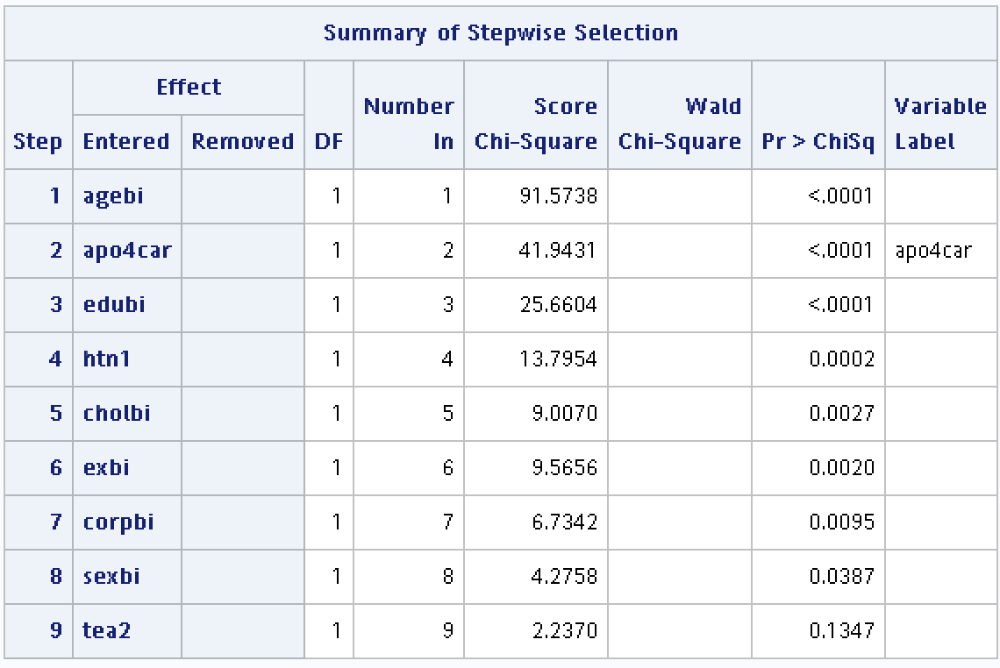
stepwise selection
Stepwise selection：
entry significance level : 0.15
exist significance level : 0.15
Remaining predictor：
hypertension
age
APOE e4 status
hyperlipidemia
education year
physical activities
social activities

Slide 28
interaction term
Forward selection
Interaction term of htn and other variables into the model
 | htn*age | htn*sex | htn*eduyr | htn*APOE | htn*ex | htn*social | htn*chol
p-value | 0.4637 | 0.8254 | 0.4212 | 0.5749 | 0.9805 | 0.1605 | 0.4441

Slide 29
result
Model
Hypertension, age, sex, APOE, education year, hyperlipidemia, social activities and physical activities
 | Crude OR | Adjusted OR
Hypertension Yes No | 0.51 (0.37 – 0.71)* 1 | 0.41 (0.26 – 0.64)* 1

Slide 30
5.
Discussion

Slide 31
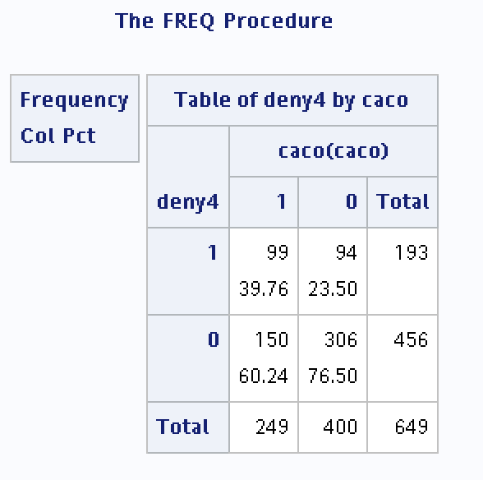
Recall bias (misclassification of exposure )
Self-defined variable : “deny4”, refers to the denial of all chronic conditions
Case (39.8) vs. control (23.5)
Chi-square p-value < 0.0001

Slide 32
Recall bias (misclassification of exposure )
Self-defined variable: “deny4”, refers to the denial of all chronic conditions
Case (39.8) vs. control (23.50)
Chi-square p-value < 0.0001
P ( deny all 4 dz | deny certain dz )
P (deny all 4 | deny htn) : case (64.3) vs. control (51.9)*
P (deny all 4 | deny chol) : case (48.5) vs. control (34.0)*
P (deny all 4 | deny dm) : case (49.0) vs. control (27.6)*
P (deny all 4 | deny cvd) : case (64.3) vs. control (51.9)*

Slide 33
Anti-hypertensive drug
 | Adjusted OR | N
Hypertension with medication without medication | 0.39 (0.25 – 0.63)* 0.86 (0.23 – 3.16) | 7 (2.8) vs. 11(2.8)
 | Crude OR | Adjusted OR
Hypertension Yes No | 0.51 (0.37 – 0.71)* 1 | 0.41 (0.26 – 0.64)* 1
Hyperlipidemia Yes No | 0.47 (0.31 – 0.69)* 1 | 0.47 (0.28 – 0.79)* 1
 | Adjusted OR | N
Hyperlipidemia with medication without medication | 0.49 (0.26 – 0.94)* 0.72 (0.32 – 1.62) | 16 (6.5) vs. 35 (8.8)
Compatible with past studies
Khachaturian As et al. Arch Neurol. 2006;63(5):686–692
Tzourio C et al.Arch Intern Med 2003;1631069- 1075

Slide 34
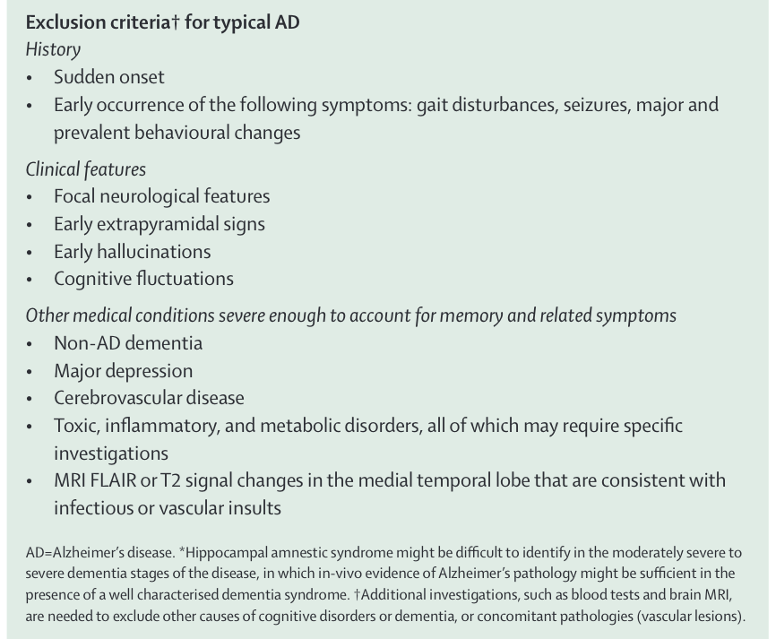
Competing risk
NINCDS-ADRDA criteria
Definite Alzheimer’s disease
Probable Alzheimer’s disease
+ Histopathological confirmation
Probable Alzheimer’s disease
Clinical and neurophysiological exams
Must be an absence of other diseases that are capable of causing dementia syndrome
The Lancet Neurology 2007 Vol. 6 Issue 8 Pages 734-746
Notes:
Javanshiri, Keivan et al. ‘Atherosclerosis, Hypertension, and Diabetes in Alzheimer’s Disease, Vascular Dementia, and Mixed Dementia: Prevalence and Presentation’. 1 Jan. 2018 : 1247 – 1258.

Slide 35
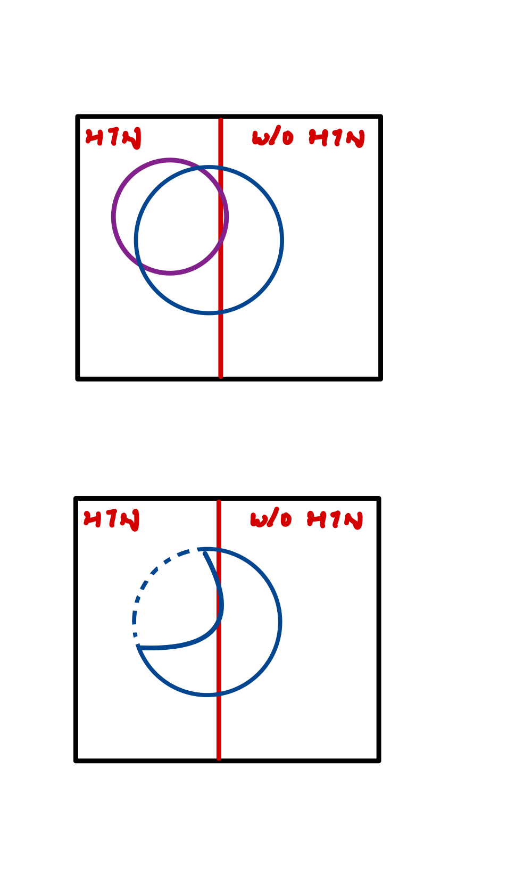
Definition of case
Vascular dementia
Alzheimer’s dementia
Notes:
Javanshiri, Keivan et al. ‘Atherosclerosis, Hypertension, and Diabetes in Alzheimer’s Disease, Vascular Dementia, and Mixed Dementia: Prevalence and Presentation’. 1 Jan. 2018 : 1247 – 1258.

Slide 36
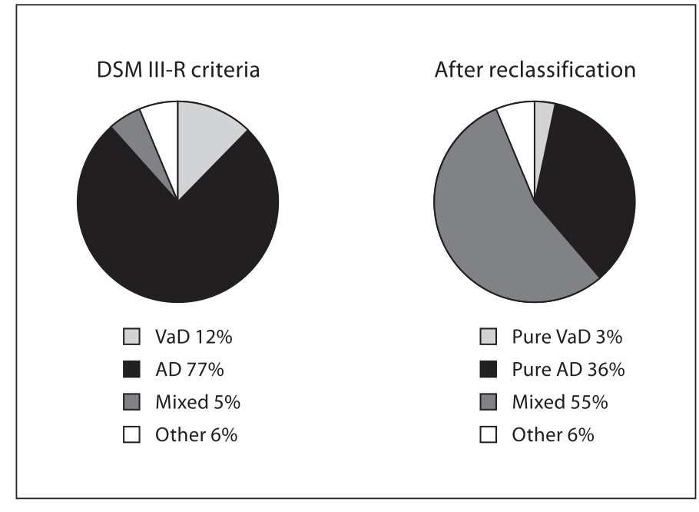
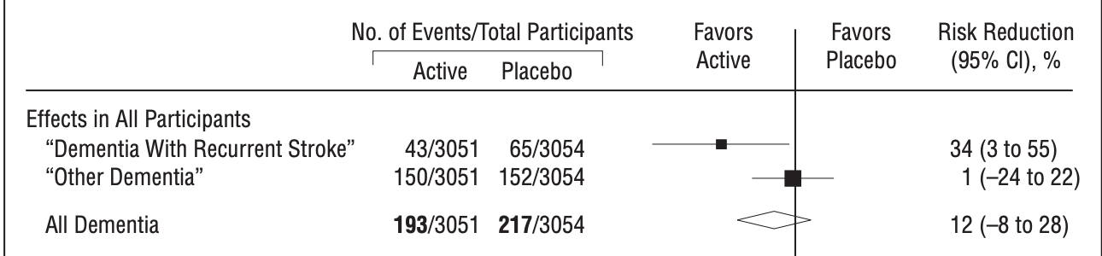
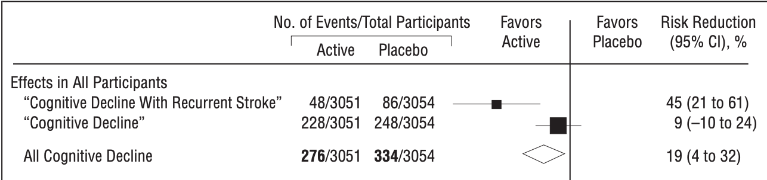
True effect of vascular dz ?
Recalcification of Kunsholmen project 1987 – 1996
Aguero-Torres H, et al. Dement Geriatr Cogn Disord. 2006;22(3):244-9.
Forette Fseux et al . Lancet. 1998;3521347- 1351
Notes:
Javanshiri, Keivan et al. ‘Atherosclerosis, Hypertension, and Diabetes in Alzheimer’s Disease, Vascular Dementia, and Mixed Dementia: Prevalence and Presentation’. 1 Jan. 2018 : 1247 – 1258.
Aguero-Torres H, et al. Dement Geriatr Cogn Disord. 2006;22(3):244-9.
Forette Fseux et al . Lancet. 1998;3521347- 1351

Slide 37
Thanks!
Any questions?

